Slide 1
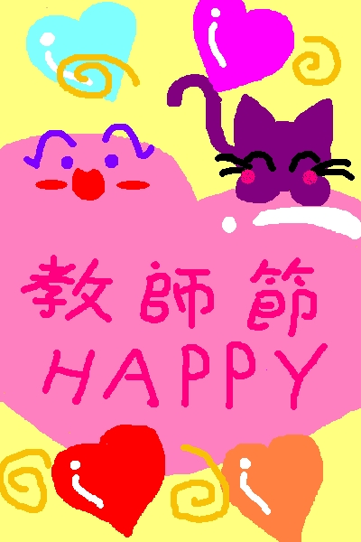
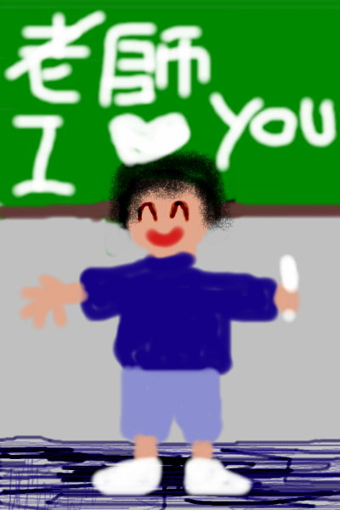
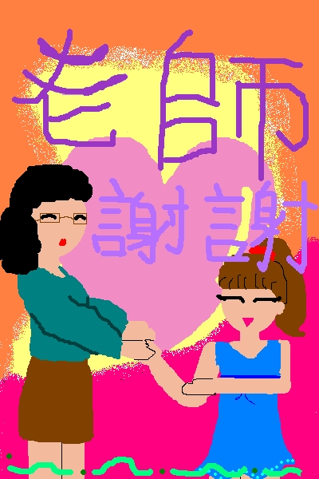
Chinese Teacher’s Day 09/28 or 09/10

Slide 2
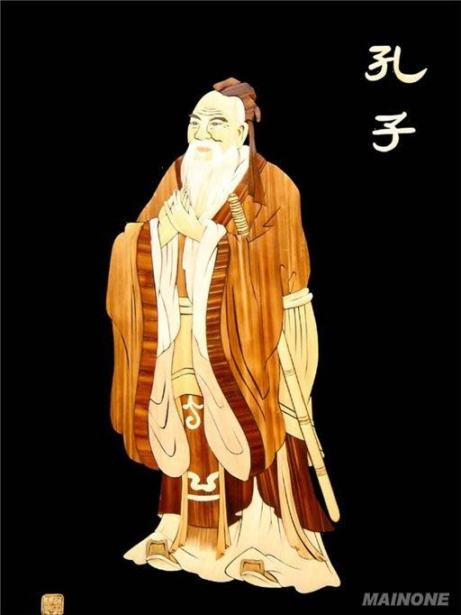
孔子是 a great thinker 是 an educator 是 the founder of Ru Jia 有3000个学生 When I walk along with two others, they may serve me as my teachers. I will select their good qualities and follow them, their bad qualities and avoid them. 三人行，必有我师焉。择其善者而从之，其不善者而改之。

Slide 3
“Xie xie” Card Project

